Slide 1

Exploiting HMM Sparity to Perform Online Real-Time Nonintrusive Load Monitoring(NILM)
IF=10.49
Stephon Makonin
Notes:
计算情报学会，通信学会，计算机学会，控制系统学会，工业应用学会，工业电子学会，仪器与测量学会，电力电子学会，电力与能源学会，信号处理学会的联合出版物。

Slide 2
menu
Abstract/Intro
ALGORITHM COMPLEXITY&EFFICIENCY
BACKGROUND
ACCURACY EXPERIMENTATION
Content
METHODOLOGY
CONCLUSION

Slide 3
Introduction
/01

Slide 4
Abstract
Understanding appliance pattern is important.
Present a new load disaggregation algorithm.

Slide 5
Contributions
design a disaggregation algorithm:
is agnostic of low frequency sampling rates and measurement types.
is highly accurate at load state classification and load consumption estimation.
can disaggregation appliances with complex multi-state power signature.
is the first hidden markov model solution that preserves dependencis between load.
can perform computationally efficient exact inference.
Notes:
对采样频率和测量类型不可知；
负荷状态分类和消费估计的精度高；
可以进行复杂多状态的电力标签分类；
是第一个保留了设备以来的马尔科夫模型的解决方案；
计算有效性准确推理。

Slide 6
BACKGOUND
/02
Notes:
电器层面的建模的重要性
NILM签名

Slide 7
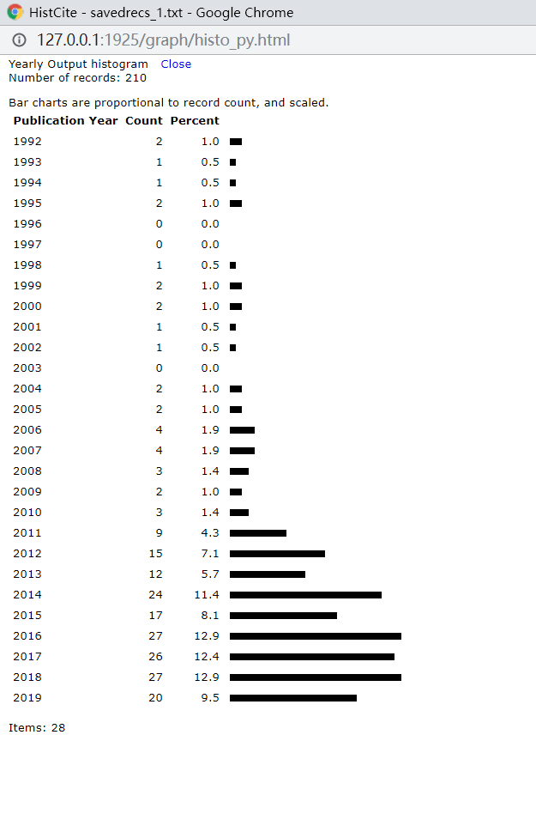
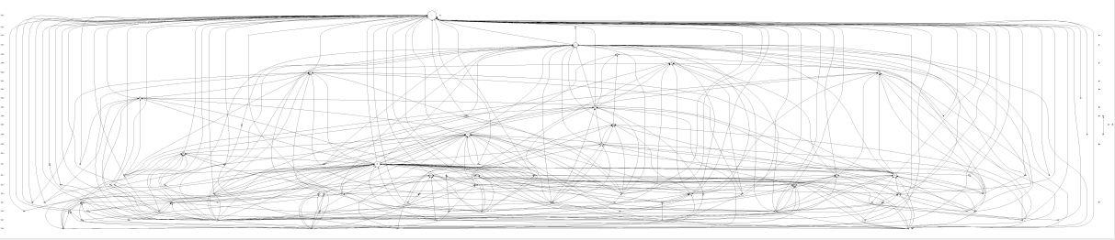
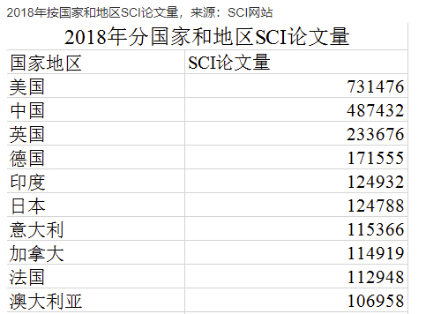
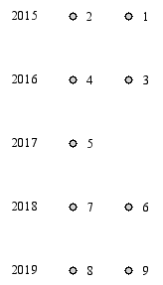
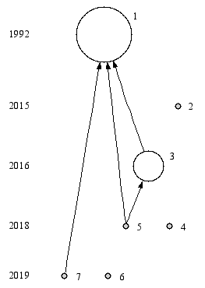
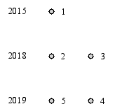
Relationship of non intrusive load monitoring 210 from webofknowledge 核心数据库
SCI papers sea
从数百篇文章中找到用于每1-2月一次的分享论文，9/13，包括WSN,定位，边缘计算，负荷分析等方向
跟负荷分析(跟项目)有关的5篇

Slide 8

NILM First
1 HART GW NONINTRUSIVE APPLIANCE LOAD MONITORING PROCEEDINGS OF THE IEEE. 1992 DEC; 80 (12): 1870-1891 LCR: 0 CR: 43 LCS: 3 GCS: 931 OCS: NILMfirst
2 DeBruin S, Ghena B, Kuo YS, Dutta P PowerBlade: A Low-Profile, True-Power, Plug-Through Energy Meter SENSYS'15: PROCEEDINGS OF THE 13TH ACM CONFERENCE ON EMBEDDED NETWORKED SENSOR SYSTEMS. 2015; : 17-29 LCR: 0 CR: 14 LCS: 0 GCS: 8 OCS:
3 Makonin S, Popowich F, Bajic IV, Gill B, Bartram L Exploiting HMM Sparsity to Perform Online Real-Time Nonintrusive Load Monitoring IEEE TRANSACTIONS ON SMART GRID. 2016 NOV; 7 (6): 2575-2585 LCR: 1 CR: 21 LCS: 1 GCS: 58 OCS: SparseNILM
4 Lu CX, Li Y, Zhao PJ, Chen CH, Xie LH, et al. Simultaneous Localization and Mapping with Power Network Electromagnetic Field MOBICOM'18: PROCEEDINGS OF THE 24TH ANNUAL INTERNATIONAL CONFERENCE ON MOBILE COMPUTING AND NETWORKING. 2018; : 607-622 LCR: 0 CR: 53 LCS: 0 GCS: 2 OCS: 简写SLAM PMF
5 Kong WC, Dong ZY, Ma J, Hill DJ, Zhao JH, et al. An Extensible Approach for Non-Intrusive Load Disaggregation With Smart Meter Data IEEE TRANSACTIONS ON SMART GRID. 2018 JUL; 9 (4): 3362-3372 LCR: 2 CR: 29 LCS: 0 GCS: 22 OCS: 简写NILD
6 Sun MY, Wang Y, Strbac G, Kang CQ Probabilistic Peak Load Estimation in Smart Cities Using Smart Meter Data IEEE TRANSACTIONS ON INDUSTRIAL ELECTRONICS. 2019 FEB; 66 (2): 1608-1618 LCR: 0 CR: 27 LCS: 0 GCS: 7 OCS: 简写LoadEst
7 Aboulian A, Green DH, Switzer JF, Kane TJ, Bredariol GV, et al. NILM Dashboard: A Power System Monitor for Electromechanical Equipment Diagnostics IEEE TRANSACTIONS ON INDUSTRIAL INFORMATICS. 2019 MAR; 15 (3): 1405-1414 LCR: 1 CR: 30 LCS: 0 GCS: 2 OCS:
PowerBlade
SparseNILM
NILD 2次
SLAM PMF
NILM Dashboard
LoadEst

Slide 9
An Extensive Approach for Non-Instrusive Load Diaggregation With Smart Meter Data
IF=10.49
Impact factor=10.49
Weicong Kong, Zhaoyang Dong, Jin Ma, David J.Hill, Fengji Luo, University of Sydney
Junhua Zhao, the Chinese University of Hong Kong

Slide 10
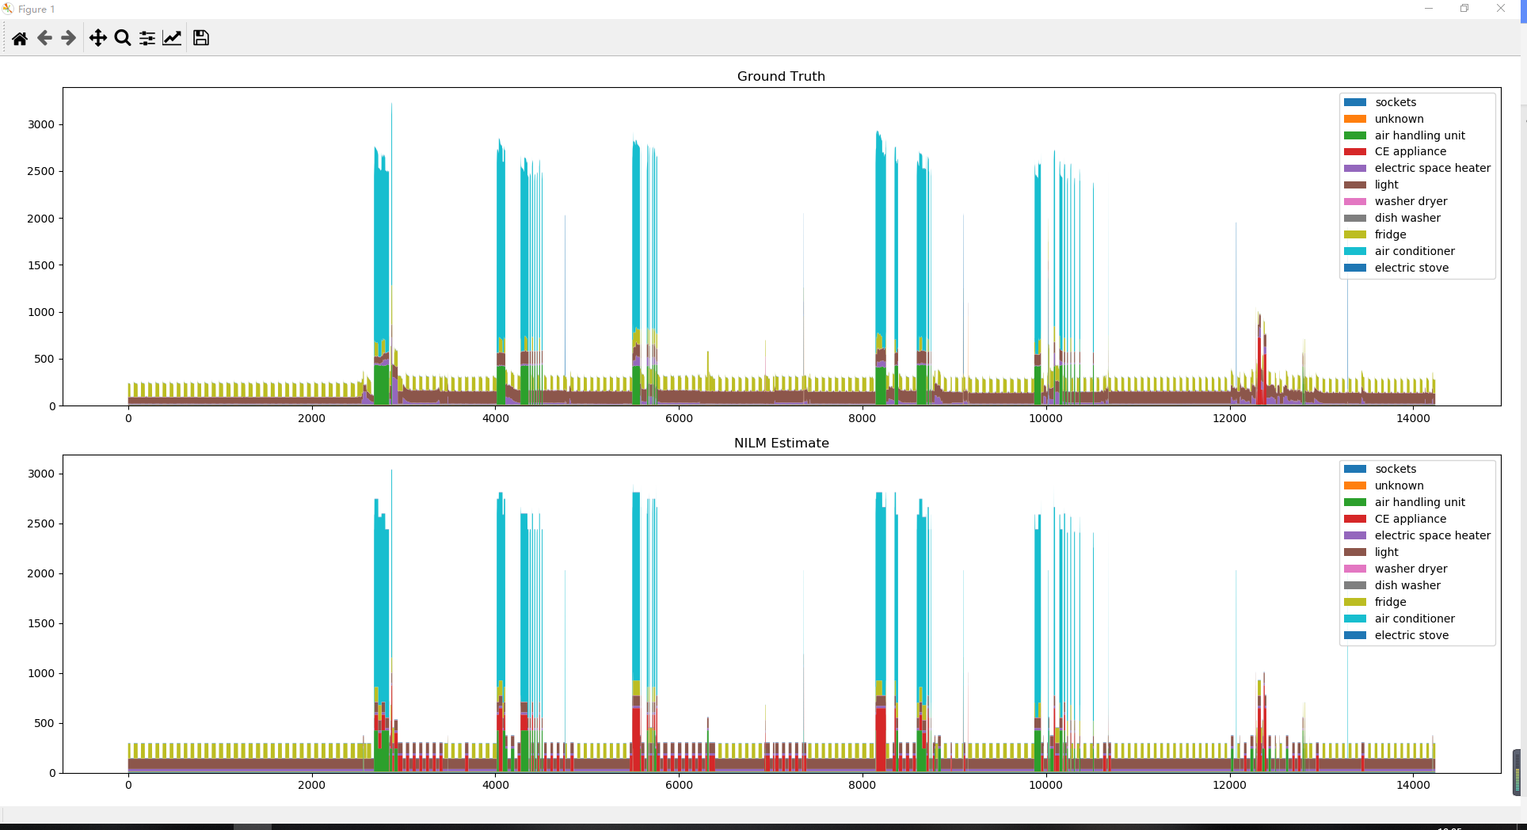
复现负荷分解的效果

Slide 11
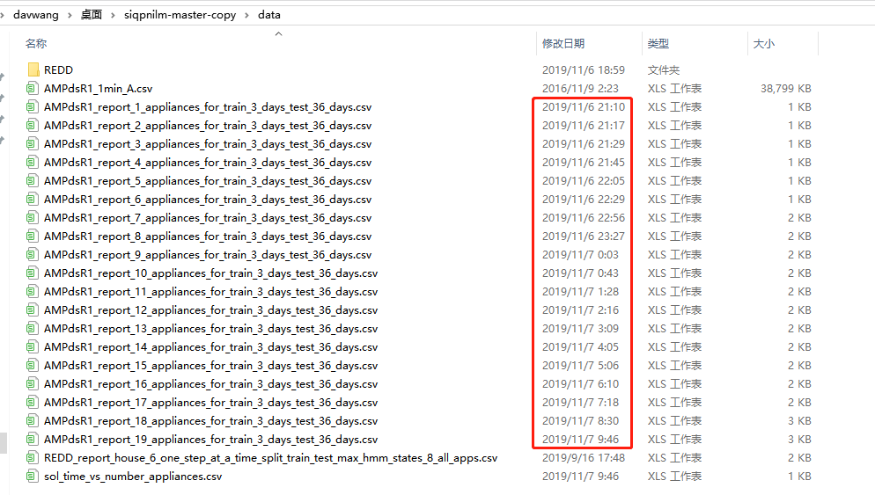
数据，原始的REDD数据集，后续生产的数据
PC上运行时间大概是12.5h

Slide 12

NILM Dashboard: A Power System Monitor for Electromechanical Equipement Diagnostics
IF=7.377
Steven B. Leeb,Fellow, IEEE, MIT RLE

Slide 13
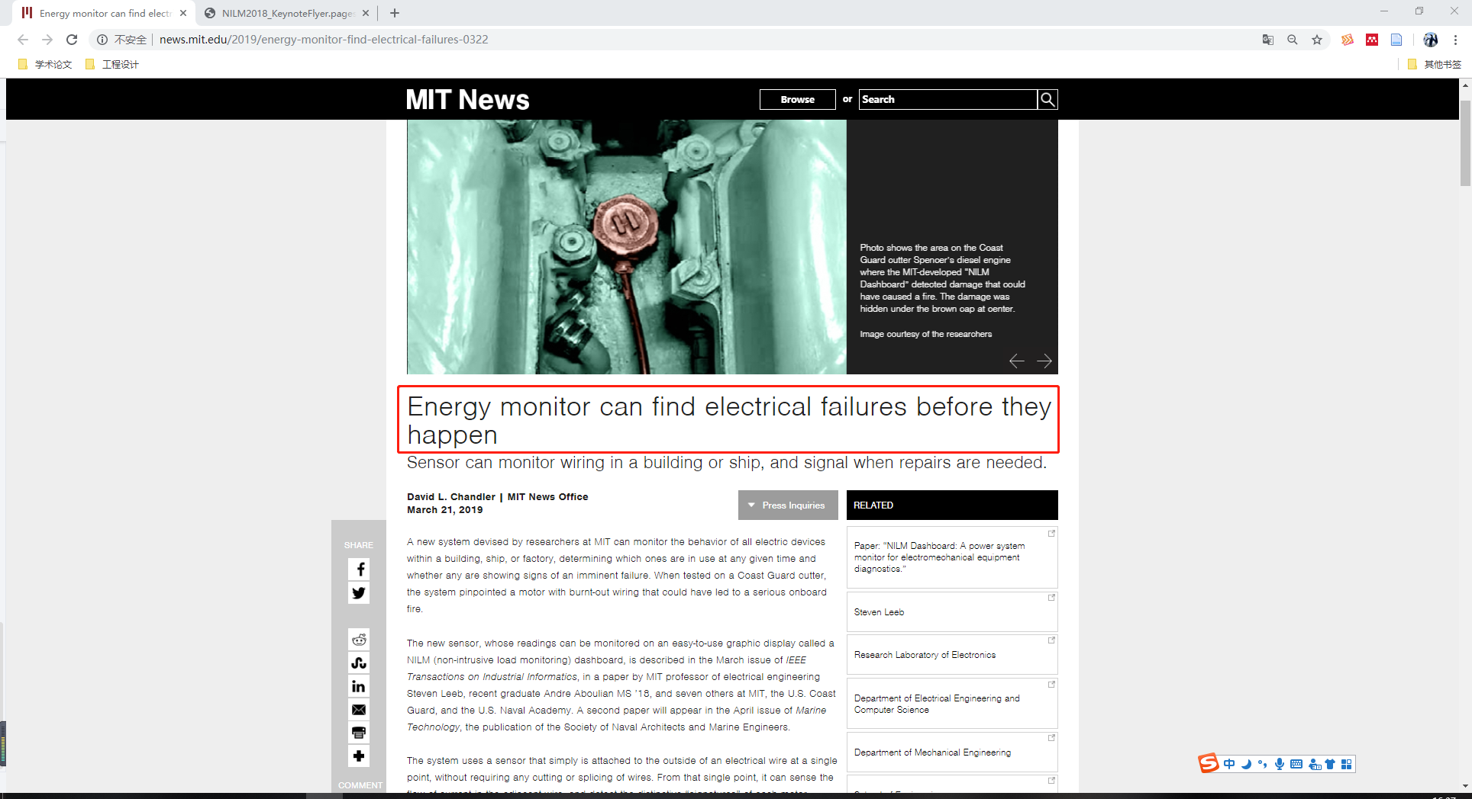

Slide 14


Slide 15
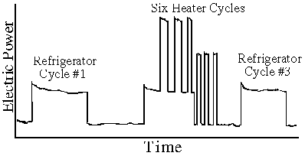
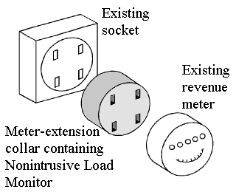

Nonintrusive Appliance Load Monitoring
Impact factor=10.694
HART MIT

Slide 16
METHODOLOGY
/03

Slide 17
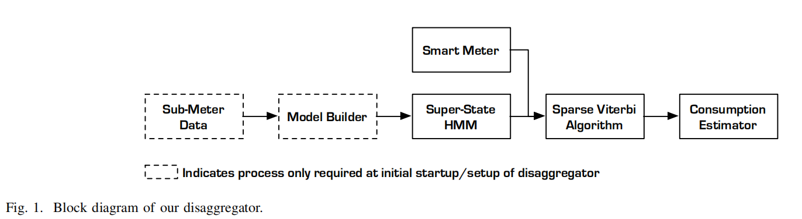
Block diagram of our disaggregator
Notes:
讲术语，
负荷消费建模，
概率质量函数，PMF
超状态HMM，
稀疏维特比算法，
负荷消费估计

Slide 18
Super-State Definition
Cartesian product of the different possible states of each appliance/load we want to disaggragate
理论上有8!=40320
super-state
dishwasher
OFF
WASH
RINSE
DRY
OFF
WASH
RINSE
DRY
light
OFF
OFF
OFF
OFF
ON
ON
ON
ON
K=2*4
Notes:
讲术语，
负荷消费建模，
概率质量函数，PMF
超状态HMM，
稀疏维特比算法，
负荷消费估计

Slide 19

Model
整个房间的可能的K个超状态
隐藏负荷或电器状态X
M个电器
A，转移矩阵(K*K)
B, 发射矩阵(K*N)
Y
可能的观察序列N个状态可能
PMF，概率质量函数，离散的概率密度函数
Notes:
讲术语，
负荷消费建模，
概率质量函数，PMF
超状态HMM，
稀疏维特比算法，
负荷消费估计

Slide 20
Standard Viterbi Algorithm
The standard Viterbi algorithm is well suited for well populated matrics
Notes:
讲术语，
负荷消费建模，
概率质量函数，PMF
超状态HMM，
稀疏维特比算法，
负荷消费估计

Slide 21
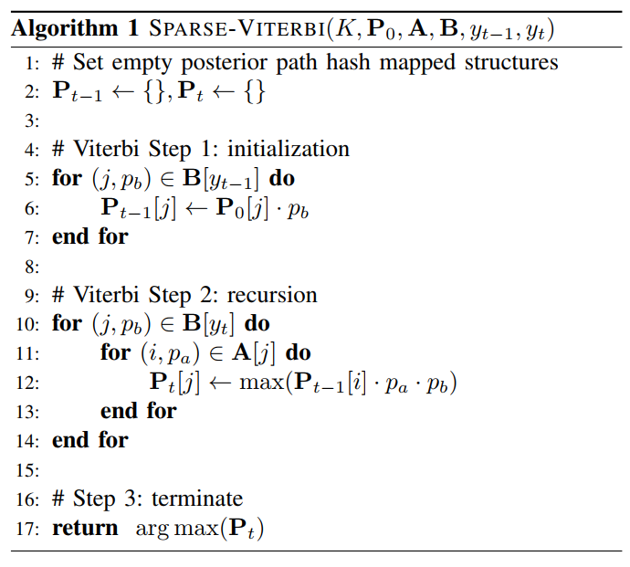
Sparse Viterbi Algorithm
Notes:
讲术语，
负荷消费建模，
概率质量函数，PMF
超状态HMM，
稀疏维特比算法，
负荷消费估计

Slide 22
ALGORITHM COMPLEXITY&EFFICIENCY
/04

Slide 23
Space Complexity
for each specific super-state
there is exactly one output
the best case sparity of B can be calculated as
the approximate space cost for A

Slide 24
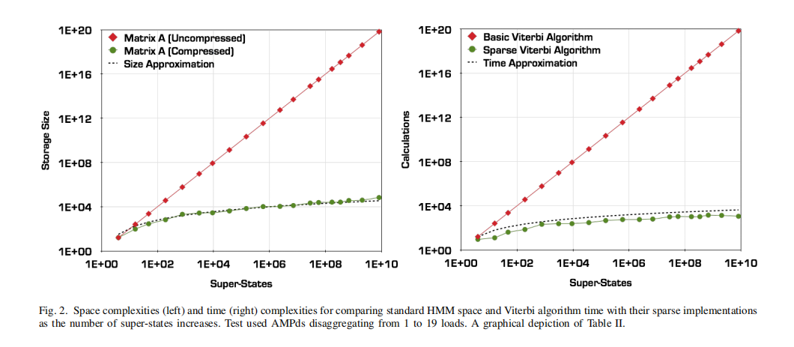
Space Complexity and Time Complexity

Slide 25
ACCURACY EXPERIMENTATION
/05

Slide 26
accuracy
Kim et al. 2010
Zeifman and Roth 2011
Makonin 2014
before, there is no consistent way to measure performance accucuracy.
Noise
FS-fscore

Slide 27
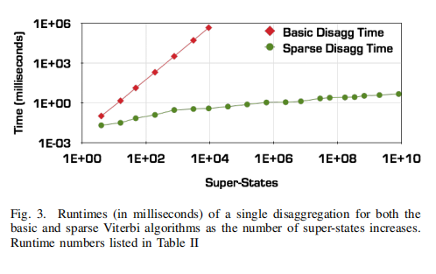
deferrable
Notes:
基本的维特比算法随着超状态的增加，耗时迅速增加，在超状态为1万的级别时候，时间达到1000秒；
稀疏维特比算法一直维持在10ms附近；

Slide 28
ANALYSIS OF ACCURACY RESULTS
/06

Slide 29
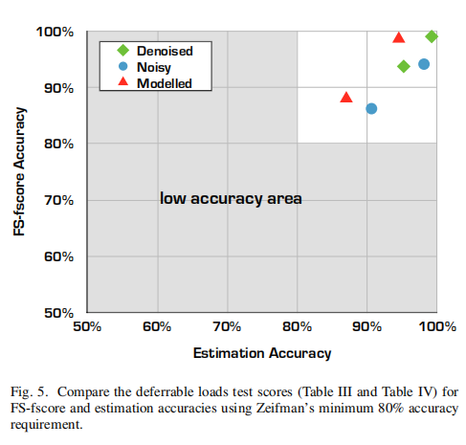
Accuracy

Slide 30
important requirement beyond accuracy
Feature selection
No training
Near Real-time
Scalability

Slide 31
Conclusion
/07

Slide 32
Conclusion
The ability to disaggregation 18 loads, as we have shown, goes far beyond the number prevously.
despite the theoretical limitations, also allow for use in practice

